Slide 1
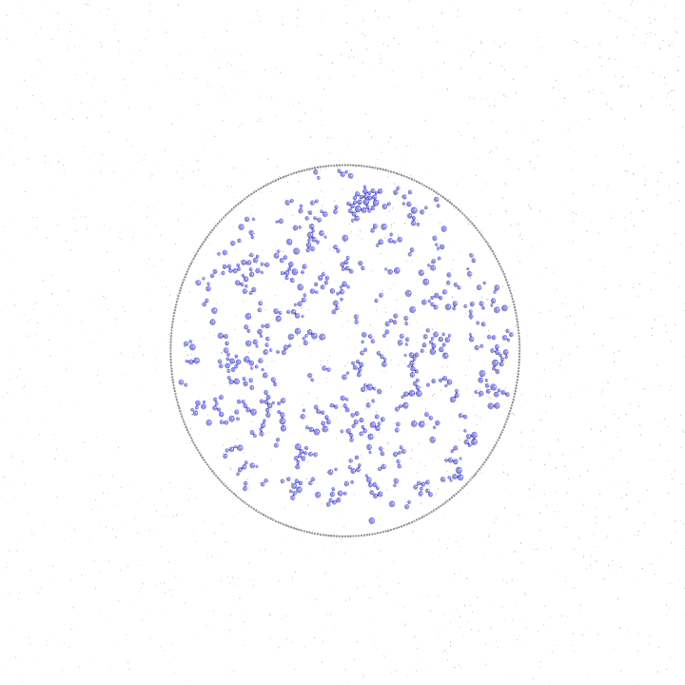
800 (micrometers)
400
Patch 400

